Slide 1
BioHeatMap: Large scale Application Built in FORWARD
Experience and Lessons Learnt at App2You

Slide 2
Background
PubMed contains 20 million articles. Its growth is accelerating at > 1 million articles per year.
Biomedical researchers doing literature search want high-level analysis and visualizations, such as:
Top researchers for a substance / disease
Has a substance fallen out of favor?
Has a substance been re-purposed to cure other diseases?

Slide 3
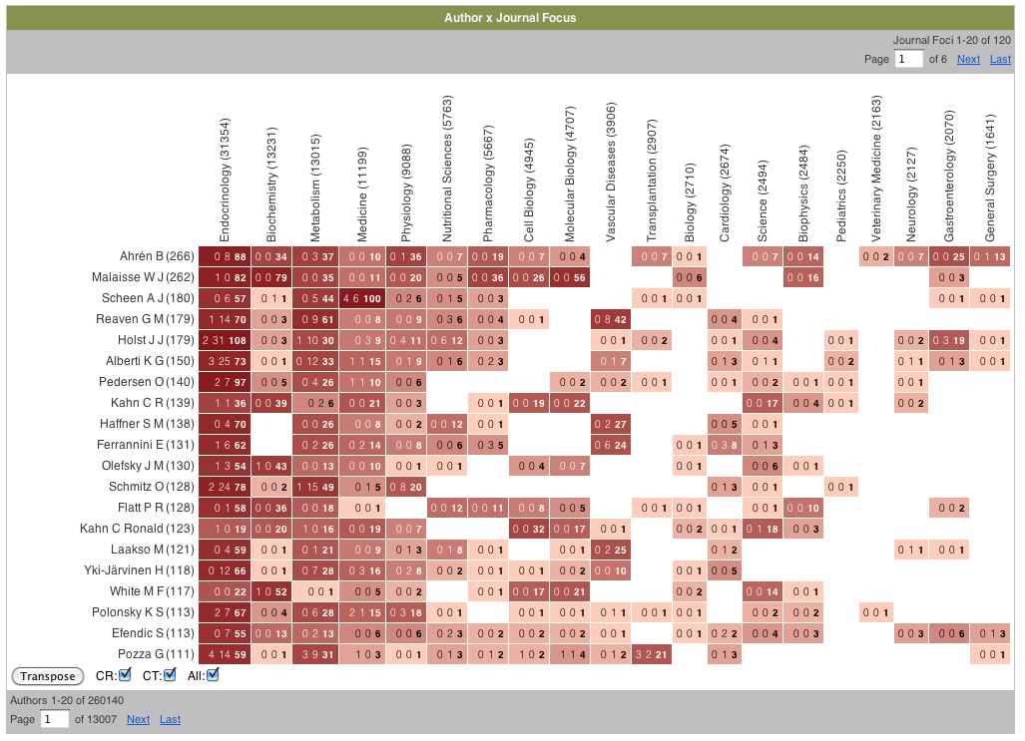

Demo

Slide 4
Architecture
PubMed
Extract, Transform, Load (ETL)
Datamart
(500 GB)
Database
Session
Page

Slide 5
Architecture
Page Config
Datamart
(500 GB)
Database
Session
Page

Slide 6
Architecture
Add Filter
Program Config
Datamart
(500 GB)
Database
Session
Query
Pattern

Slide 7
Architecture
Search Program Config
Dynamic Query Service
DML
Datamart
(500 GB)
Database
Session
Query
Results
Query
Pattern

Slide 8
Lines of Code Statistics
Type | Lines of Code | Percentage
Program configurations | 8523 | 33%
Page configurations | 3998 | 15%
CSS | 1080 | 4%
SQL (ETL, Dynamic query templates) | 4397 | 17%
Java (Dynamic queries) | 7508 | 29%
Shell scripts | 280 | 1%
Total | 25786 | 100%

Slide 9
FORWARD Difficulties
Code duplication due to lack of procedures
Code duplication due to program’s tree structure (lack of if-then-else merge points)
Verbose syntax for programs
Mundane programs to copy from core data object to UAS
Manual buffering of search results (lack of incremental view maintenance)
Lack of support for dynamic queries
Lack of declarative access control

Slide 10
1. Code duplication due to lack of procedures
Example
The dynamic query service is invoked at 18 call sites.
Each call site requires some additional post-processing DML statements, such as copying results to page data object, adding query pattern to history, setting title etc.
Currently, all such DML statements are duplicated.

Slide 11
2. Code duplication due to program’s tree structure
Current
Proposed
if (condition) then
insert ...
update ...
update ...
update ...
else
delete ...
update ...
update ...
update ...
end if
if (condition) then
insert ...
else
delete ...
end if
update ...
update ...
update ...

Slide 12
3. Verbose syntax for programs
Current
Proposed
<program name="/close-dialog">
<dml>
<input query="{ update ... }" />
<outcome name="success">
<decision>
<input query="{ boolean ... }" />
<outcome name="yes">
<dml>
<input>
delete ...
</input>
<outcome name="success">
<page>
<input query="{'/main'}" />
</page>
</outcome>
</dml>
</outcome>
<default>
<page>
<input query="{'/main'}" />
</page>
</default>
</decision>
</outcome>
</dml>
</program>
program "/close-dialog"
begin
update ... ;
if ( boolean ... ) then
delete ... ;
end
page ('/main') ;
end
27 lines vs 8 lines

Slide 13
4. Mundane programs to copy from core data object to UAS
Classical MVC architecture for pages
Model objects (e.g. query pattern) stored in UAS (can be page-scoped, session, database etc.)
Page is a View over model objects in UAS
Programs (Controller) update model objects when user interaction occurs
25 (out of 102) programs are trivial: one DML statement to update model objects

Slide 14
5. Manual buffering of search results (lack of inc. view maintenance)
The dynamic query for each report item takes 500ms to run.
A page usually contains 6 report items.
Pagination on one report item should take 500ms instead of 3000ms.
Current: manual incremental computation. Programs manually buffer report items in data objects, so that report items that do not change are not re-computed.
Proposed: incremental view maintenance.

Slide 15
6. Lack of support for dynamic queries
FORWARD requires all queries to be provided at compile time.
Current: A dynamic query service uses the query pattern as input, generates a SQL query, and outputs the results.
Recurring theme in even simpler FORWARD applications for sorting and filtering.
Proposed (preliminary ideas): a user-defined function in query language, which inputs query patterns and outputs query results.

Slide 16
7. Lack of declarative access control
A page / program may need authentication and authorization.
Current (secure): Each of the 102 programs checks if user is authenticated, and if authenticated user is authorized to invoke.
Current (hack): Each of the 4 pages has a switch statement that checks the same. Can be easily circumvented by anyone with a JavaScript debugger.
Proposed: Declarative access control similar to web.xml
<security-constraint>
<web-resource-collection>
<url-pattern>/admin/*</url-pattern>
</web-resource-collection>
<auth-constraint>
<role-name>manager</role-name>
</auth-constraint>
</security-constraint>

